Slide 1
Mobility Assessment Tools
Farhan shah
BS P&O, M.Phil. (Public Health)
Demonstrator P&O
KMU Peshawar

Slide 2
Table of contents
Time up and go
Berg balance scale
Gross motor function classification system (GMFCS)

Slide 3
TIME UP and GO
Simple screening test that is a sensitive and specific measure of probability for falls among older adults.
To determine fall risk and measure the progress of balance, sit to stand and walking.
A recent study published in 2022 found that the TUG test is a strong mortality predictor, displacing other established risk factors such as chronic diseases in geriatric populations of low and middle income countries

Slide 4
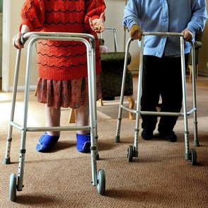
Intended Population
Parkinson's Disease.
Multiple Sclerosis.
Alzheimer's.
Hip fracture.
Total Knee Arthroplasty.
Total Hip Replacement.
Stroke.

Slide 5
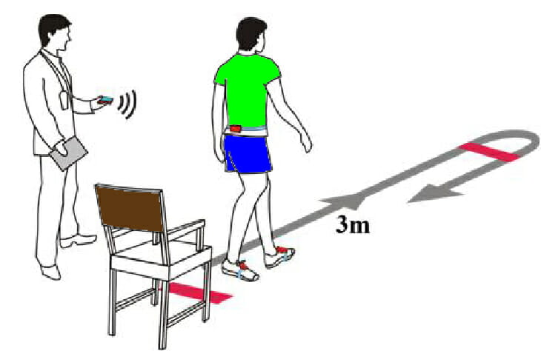
Materials Needed
One chair with armrest
Stopwatch
Tape (to mark 3 meters)

Slide 6
Method
Patients wear their regular footwear and can use a walking aid, if needed.
The patient starts in a seated position
The patient stands up upon therapist’s command: walks 3 meters, turns around, walks back to the chair and sits down.
The time stops when the patient is seated.
Be sure to document the assistive device used.

Slide 7
Observations
Observe the patient’s postural stability, gait, stride length, and sway.
Note all that apply: Slow tentative pace; Loss of balance; Short strides; Little or no arm swing; Steadying self on walls; Shuffling; En bloc turning; Not using assistive device properly.
These changes may signify neurological problems that require further evaluation.

Slide 8
Cut-off time for high risk of falls
An older adult who takes ≥12 seconds to complete the TUG is at risk for falling.
Cut of scores indicating risk of falls by Population (in seconds)
Community dwelling adults - 13.5
Older stroke patients - 14
LE amputees - 19
Hip OA - 10 -
Vestibular disorders - 11.1
Cut-off times to classify subjects as high risk for falling vary based on the study and participants.

Slide 9
Benefits
Quick to conduct
Minimal equipment required
Highly reliable and valid
Provides useful outcomes related to reduced falls risk

Slide 10
Negatives
Unable to predict falls in the community
Test re-test user error can be high
Turning is only assessed in the patient's preferred direction

Slide 11

Berg Balance Scale
The Berg Balance Scale (BBS) is used to objectively determine a patient's ability (or inability) to safely balance during a series of predator
It is a 14 item list with each item consisting of a five-point ordinal scale ranging from 0 to 4, with 0 indicating the lowest level of function and 4 the highest level of function and takes approximately 20 minutes to complete. It does not include the assessment of gait. Mined tasks

Slide 12
Intended Population
Elderly population with balance impairments, patients with acute stroke

Slide 13
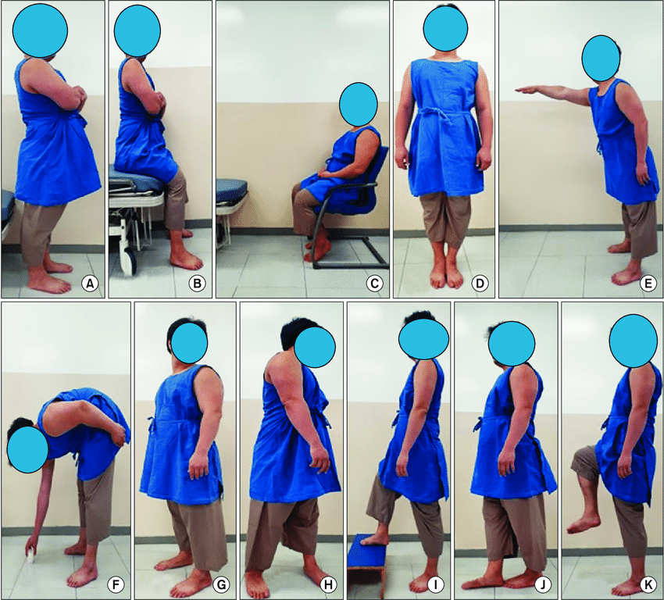
Method of Use
A ruler
2 standard chairs (one with arm rests, one without)
A footstool or step
15 ft walkway
Stopwatch or wristwatch

Slide 14
Name: __________________________________ Date: ___________________
Location: ________________________________ Rater: ___________________
ITEM DESCRIPTION SCORE (0-4)
Sitting to standing ________
Standing unsupported ________
Sitting unsupported ________
Standing to sitting ________
Transfers ________
Standing with eyes closed ________
Standing with feet together ________
Reaching forward with outstretched arm ________
Retrieving object from floor ________
Turning to look behind ________
Turning 360 degrees ________
Placing alternate foot on stool ________
Standing with one foot in front ________
Standing on one foot ________
Total ________

Slide 15
General instructions for completing the scale
The subject should understand that they must maintain their balance while attempting the tasks. The choices of which leg to stand on or how far to reach are left to the subject. Poor judgment will adversely influence the performance and the scoring.

Slide 16
Interpretation
Cut-off scores for the elderly were reported by Berg et al 1992 as follows :
A score of 56 indicates functional balance.
A score of < 45 indicates individuals may be at greater risk of falling.
A score of ≤49 indicates a risk of falls in individuals with stroke

Slide 17
Limitations
In ataxic clients it cannot, however, reflect problems in the performance of daily living activities, which are caused by the effects of ataxia on the upper extremities, because none of the items are designed to do this.

Slide 18
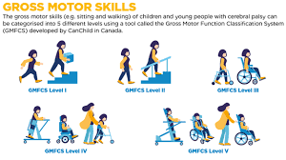
The Gross Motor Function Classification System (Expanded & Revised)
It was developed in 2007. It builds on the original version of the Gross Motor Function Classification System from 1997. It categorizes children with cerebral palsy in terms of their self-initiated gross motor fun
This five-level classification system focuses on wheeled mobility, walking and sitting. A child is classified based on their ability to perform certain functional activities and their need for assistive technology (such as canes, crutches or walkers) or wheeled mobility. The GMFCS - E&R also looks at quality of movement, but in much less details.

Slide 19
Intended Population
This classification system is intended for children and young people with cerebral palsy. The revised version (GMFCS - E&R) includes five age ranges The age groups are: under 2 years, 2-4 years, 4-6 years, 6-12 years, and 12-18 years of age.
The GMFCS - E&R is available in 22 languages and has been validated in many different countries. It is intended to classify function - it is not a diagnostic tool.

Slide 20
Method of Use
Physiotherapists, occupational therapists, physicians, and other health / rehabilitation service providers familiar with the movement abilities of children with cerebral palsy can use the GMFCS - E&R.
Parents / caregivers of children with cerebral palsy are also able to classify their children using an adapted version known as the GMFCS Family Report Questionnaire

Slide 21
The levels are as follows:
Level I: able to walk without limitations
Level II: can walk with limitations (e.g. balance, endurance limitations)
Level III: can walk using a hand-held mobility device (may use additional support, such as wheeled mobility, for longer distances, outdoors)
Level IV: self-mobility is limited - may be transported in a manual wheelchair or may use powered mobility
Level V: transported in manual wheelchair

Slide 22
Evidence
There is strong evidence for the reliability and construct validity of the GMFCS - E&R when used by both health professionals and families/caregivers, which indicates that it can be used in research and clinical practice
Various studies have shown that its intra- and inter-reliability is "almost excellent" with high intraclass correlation coefficient.
Palisano et al.used Delphi survey consensus methods (where consensus was defined as "agreement with a question by at least 80% of participants") to confirm the content validity of the GMFCS - E&R.

Slide 23
The GMFCS - E&R cannot be used to detect change over time] Towns et al. note that it cannot be used as an outcome measure to check progression or changes after treatment and it is not intended for conditions other than cerebral palsy.
While the GMFCS - E&R has been considered a stable measure, it has been found that a child's GMFCS level can change. Research on the stability of the GMFCS - E&R is ongoing.

Slide 24
thanks

